Slide 1
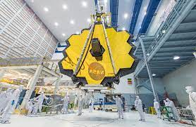
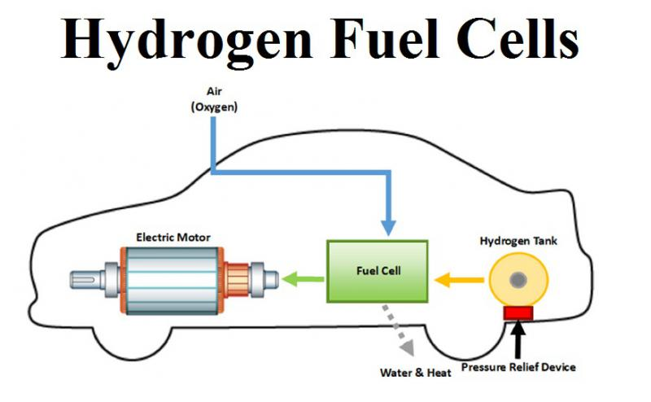
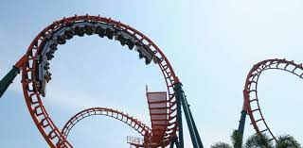
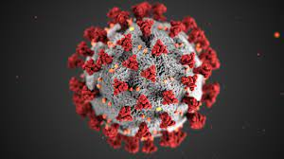
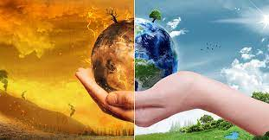
Why Science?

Slide 2
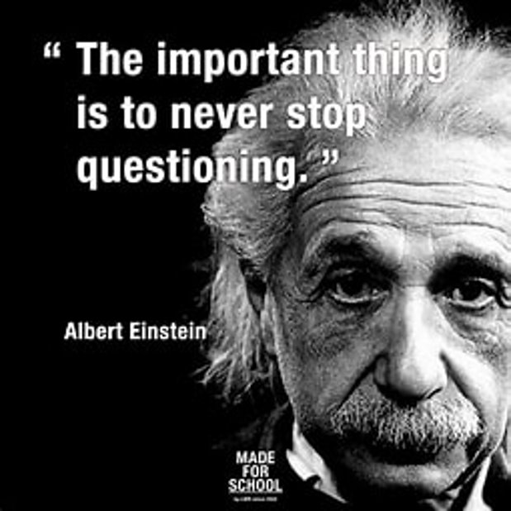
Why Choose Combined Science?
You study all 3 sciences (Biology, Chemistry and Physics)
Obtain 2 GCSEs in Science
Gives you a solid foundation in the fundamentals of science and how science shapes and explains the world around you
Gives you the skills of scientific process to evaluate claims and make judgements about media and online claims that affect your life and health
It is compulsory to study Combined or Triple science at GCSE

Slide 3
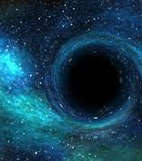
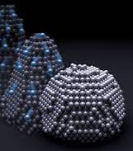
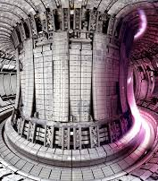
Why Choose Triple Science?
You study everything in combined science plus additional content taught during additional lesson time
You obtain 3 separate GCSEs in science (9-1)
Strongly recommend if you think you might want to study any of the sciences at A-level or if you just enjoy the subject
A more challenging course and requires you to be working at M+ standard or higher at KS3 science and a minimum of Grade 4 During Year 9.

Slide 4
How You Will Be Assessed
Combined
Triple
Obtain 2 science GCSEs as a double award
Sit 6 exams at the end of year 11
Each exam is worth 70 marks
Higher level
4-4 to 9-9
Foundation level
1-1 to 5-5
Obtain 3 independent GCSEs in Biology, Chemistry and Physics
Sit 6 exams at the end of year 11
Each exam is worth 100 marks
Higher level
4 to 9
Foundation level
1 to 5

Slide 5
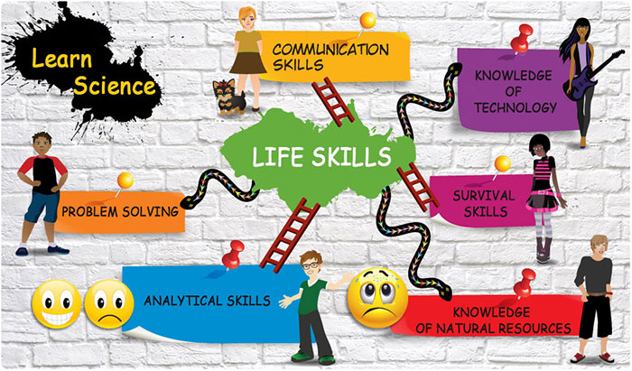
Where Can Science Take You?
Science is a facilitating subject meaning that it opens doors to lots of subjects and careers

Slide 6
Who To Contact
Speak to any of your science teachers
Email Gary.Griffiths@thirskschool.org

